Slide 1

Network Congestion Analysis and Anomaly Detection
Mini Project - II
Team Members:
Shani Kumar Gupta (171500308)
Mudit Mangal (171500194)

Slide 2
Introduction
We are living in the are of networks and internet.
Internet and communication have become an important part of our life.
Almost everyone is connected through telecommunication and everything, we perform through internet.
Which leaves us more vulnerable towards attack and due to heavy communication on telecommunication network which causes congestion.
In network congestion means heavy traffic in the network due to the overload of subscriber.
An attack is defined as:
i) Any actions that compromise the availability, confidentiality and integrity of a system.
ii) Four major classes of attacks are:
a) DOS (Denial of Service)
b) Probe
c) R2L (Remote to Local)
d) U2R (User to Root)
To reduce congestion in the telecommunication network and to stop potential threats on internet, use Arima Model to identify Congestion and for anomaly, Intrusion Detection Systems are used.

Slide 3
Problem Statement
Network Congestion is one of the primary causes of :
Performance degradation
Performance variability
Poor scaling in communication-heavy parallel applications
Low Bandwidth
We need new approaches to analyze, model and predict this critical behavior in order to improve the performance of large-scale parallel applications.
Anomaly in the network is one of the primary causes of:
Network Security break
Packet drop
Confidential information will be lost

Slide 4
Main Objective
Analyze the different factors of congestion
Predict the congestion in the network based on past data
Analyze the security aspects of the network and anomaly detection
Bandwidth Cost Prediction
Detect Anomaly in the network

Slide 5
Use Cases:
Cost prediction based on the required bandwidth
Most of the time in festival congestion increase so to tackle these type of situation
Decrease high bandwidth use
Create customizable network traffic report
Detect and prevent the network anomaly

Slide 6
Requirements:
Hardware Requirement Specification
Computer system with minimum of 8GB ram
ii) Large Dataset Hardware recommendation
Software Requirement Specification
Windows/Linux OS
Jupyter Notebook
Programming language Specification
Python
ML Algorithm

Slide 7
Specifications:
Firstly analyze the different factors in the network
Apply algorithm to predict the accuracy of the factors which actually effect the network
Cost Prediction
Security aspects of the network so that we can reduce the packet loss, drop calls and network failures
Then we will apply the Machine Learning Algorithm to predict the congestion and anomaly detection

Slide 8
References of Datasets:
https://www.kaggle.com/naebolo/predict-traffic-of-lte-network
https://www.kaggle.com/crawford/computer-network-traffic
https://www.kaggle.com/galaxyh/kdd-cup-1999-data

Slide 9
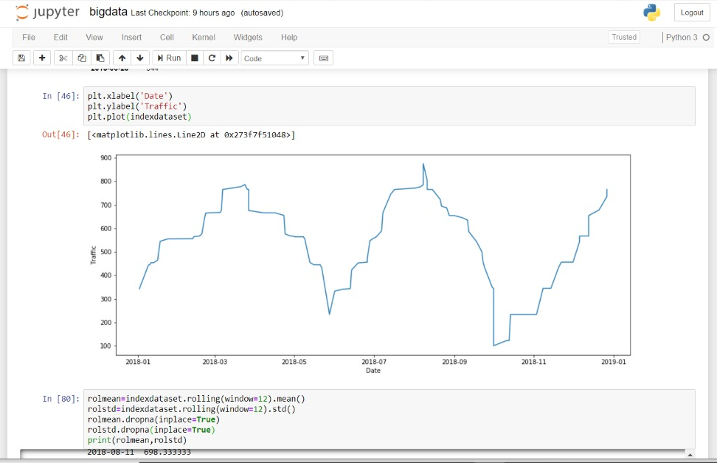
Project Output:
Network Congestion Analysis:

Slide 10
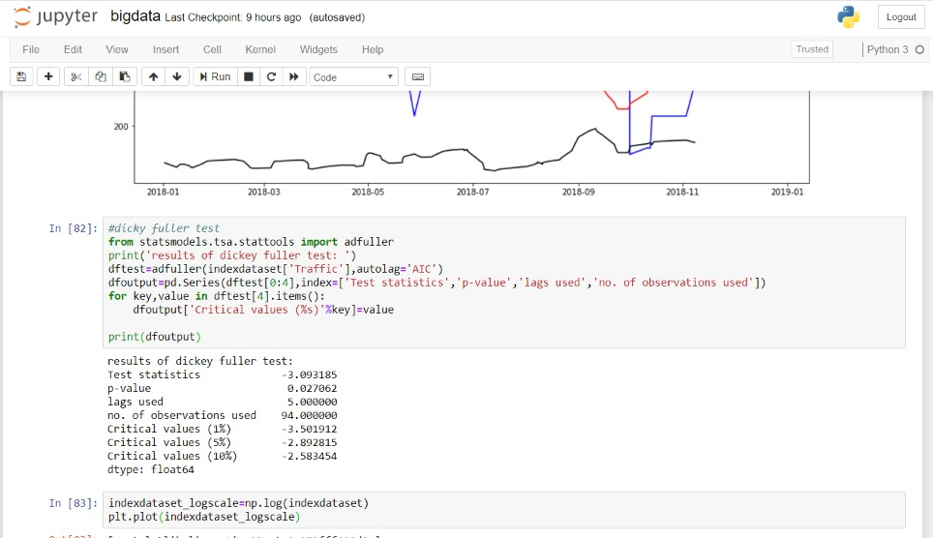
Network Congestion Analysis:

Slide 11
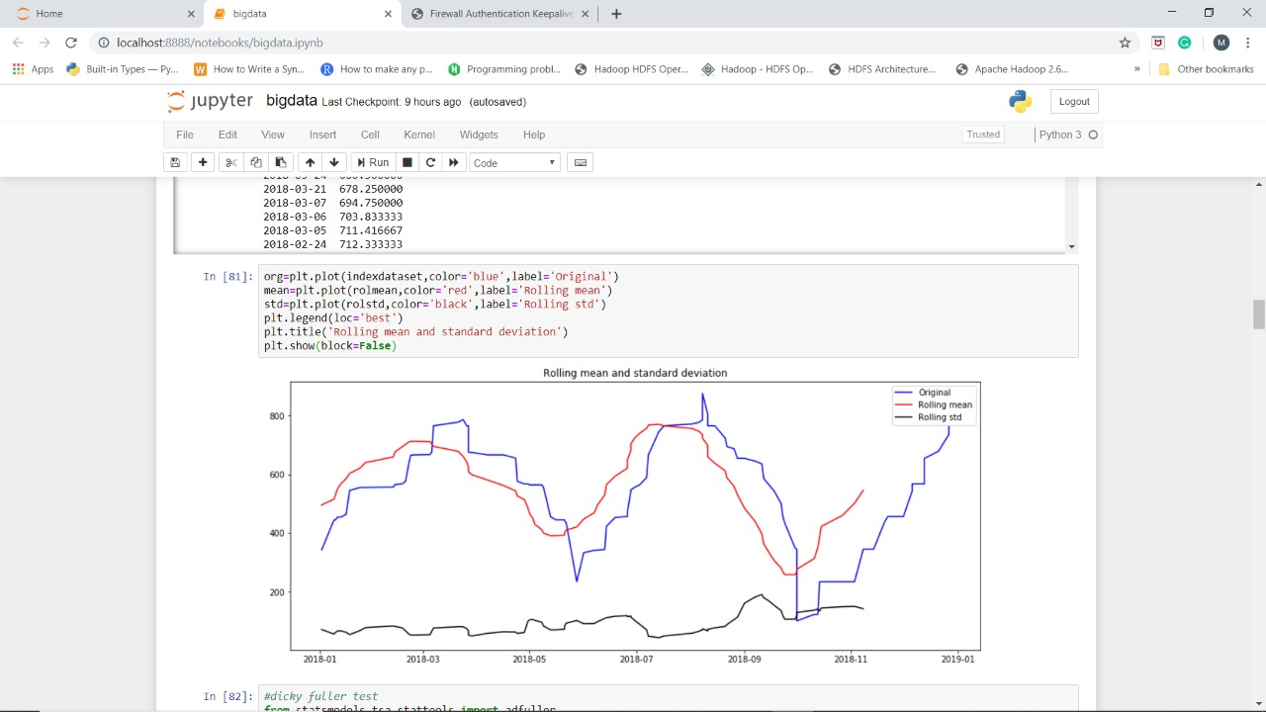
Network Congestion Analysis:

Slide 12
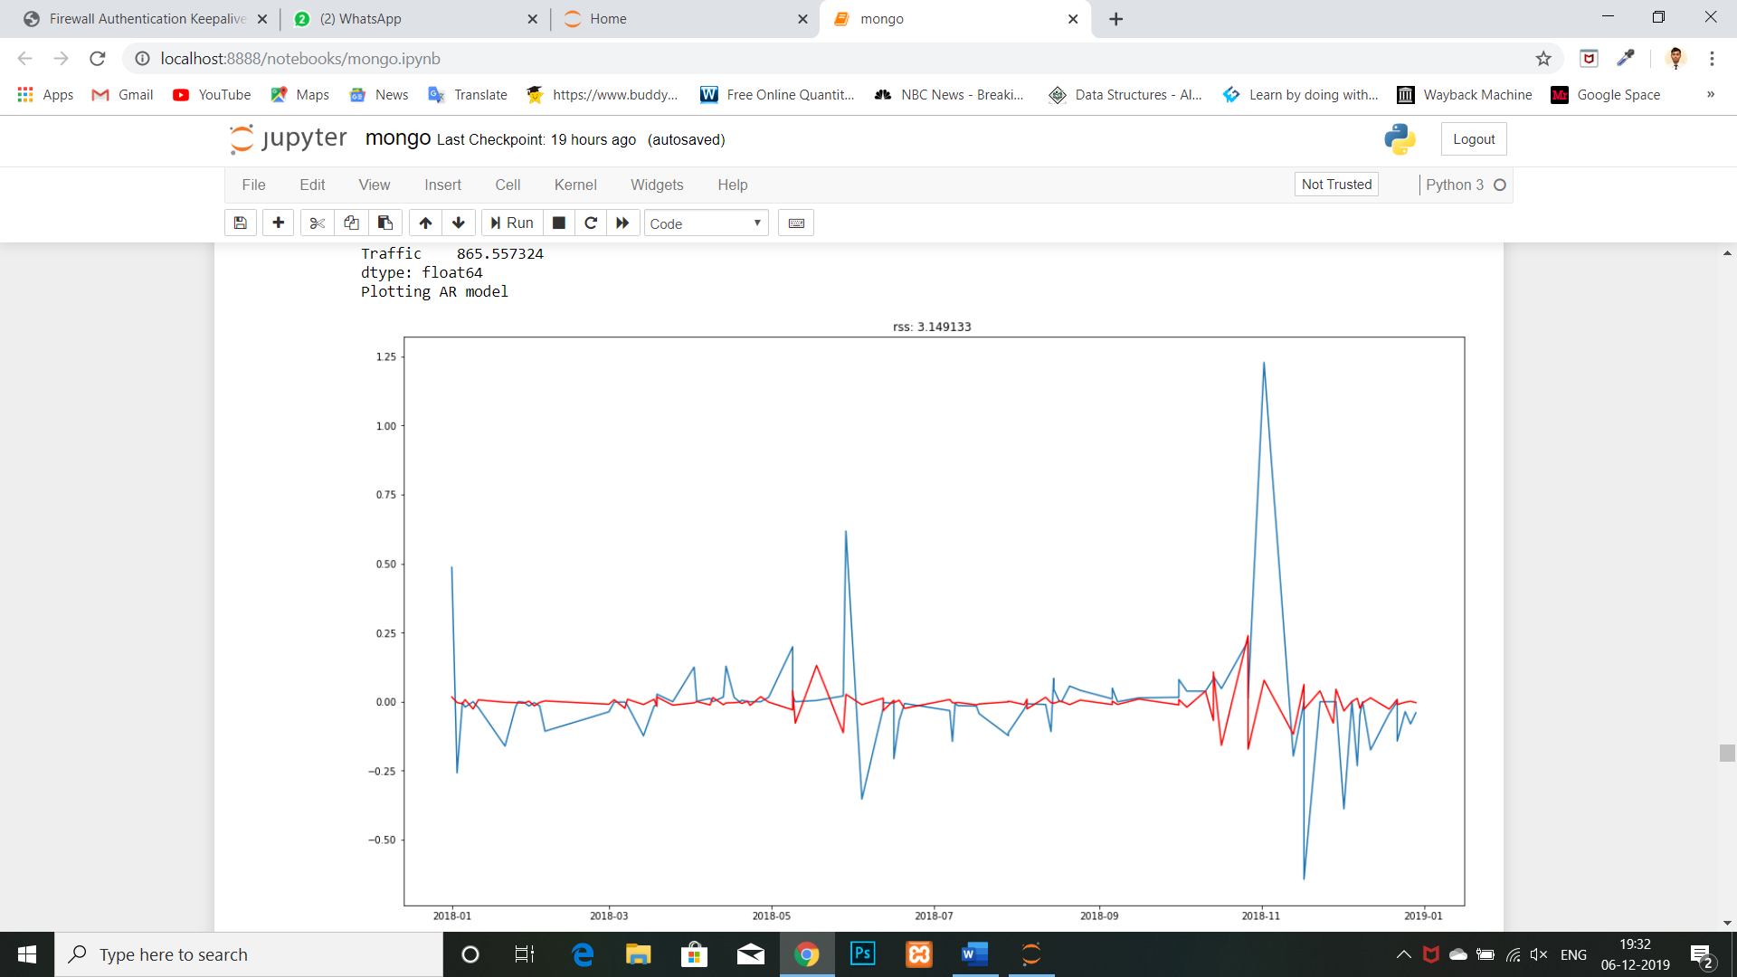
Network Congestion Analysis:

Slide 13
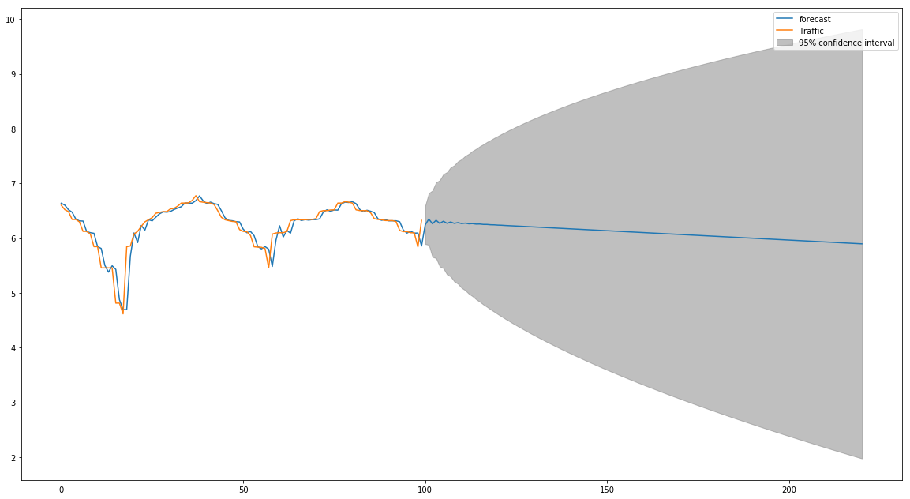
Network Congestion Analysis:

Slide 14
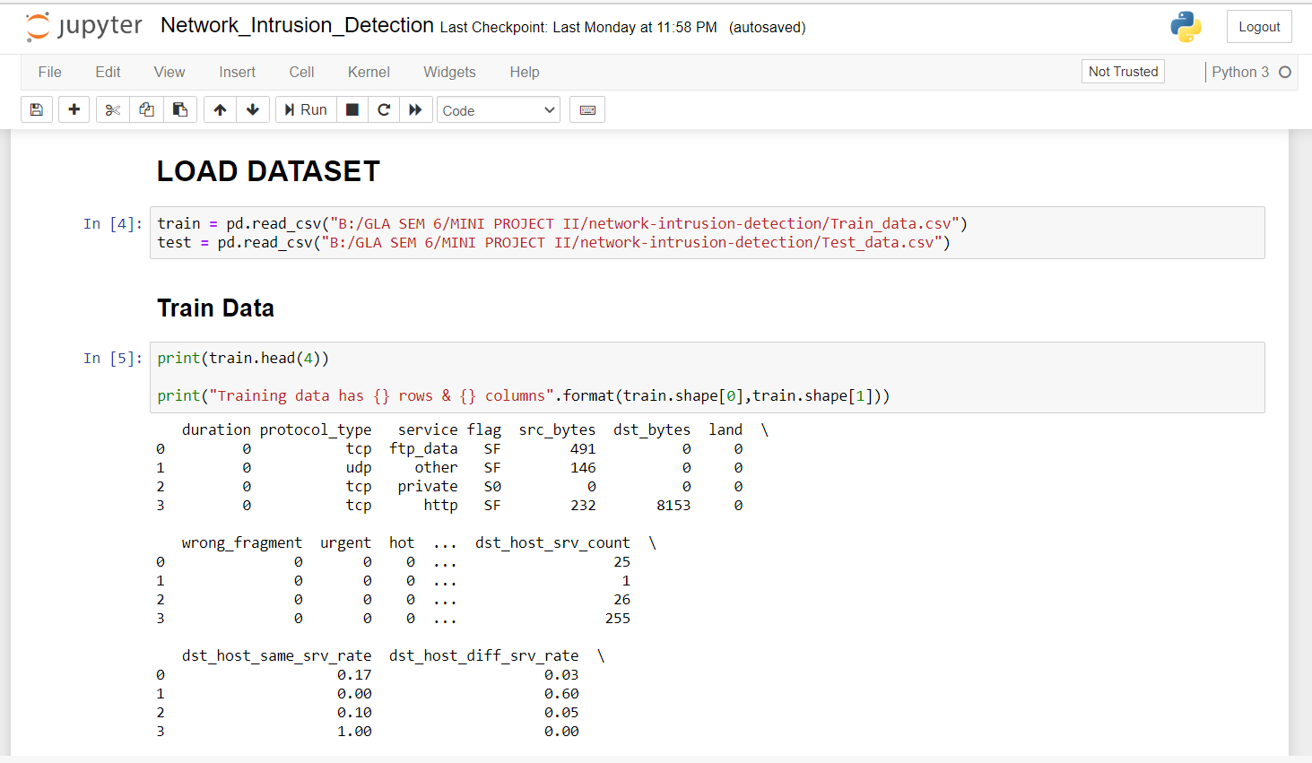
Project Output:
Network Anomaly Detection:

Slide 15
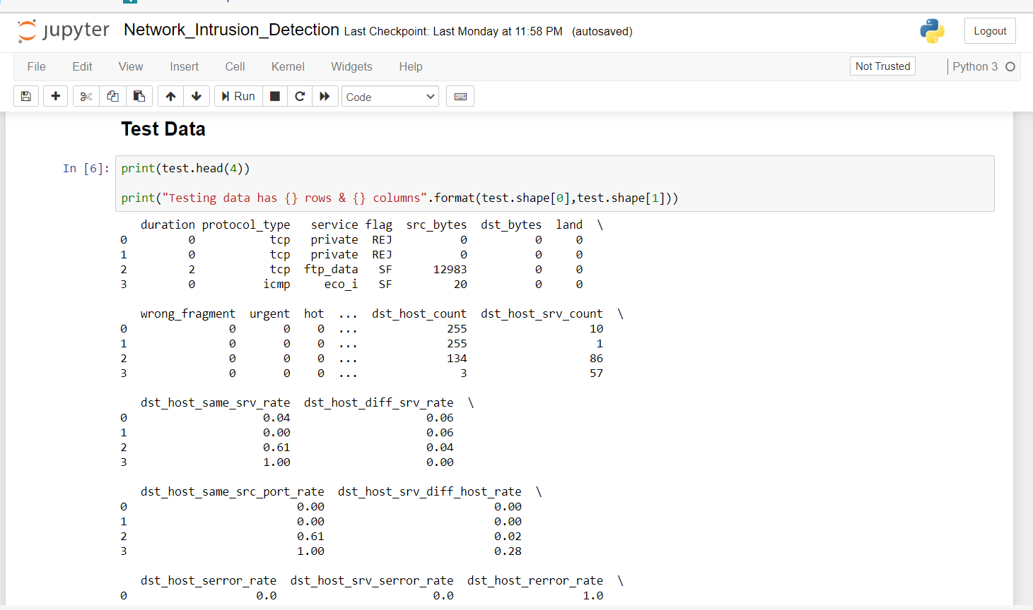
Network Anomaly Detection:

Slide 16
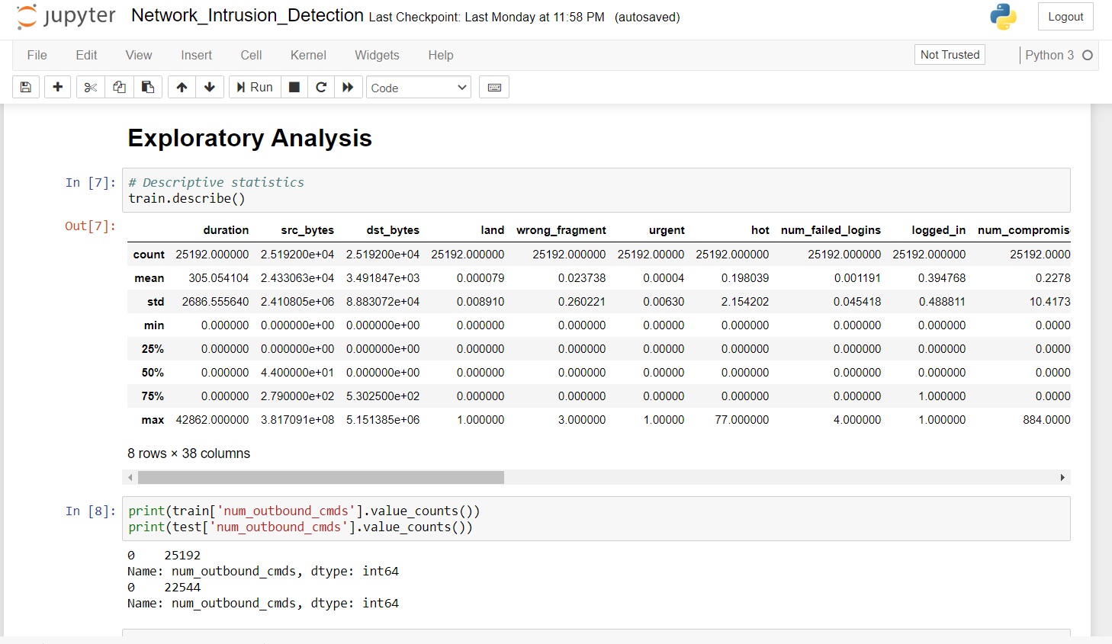
Network Anomaly Detection:

Slide 17
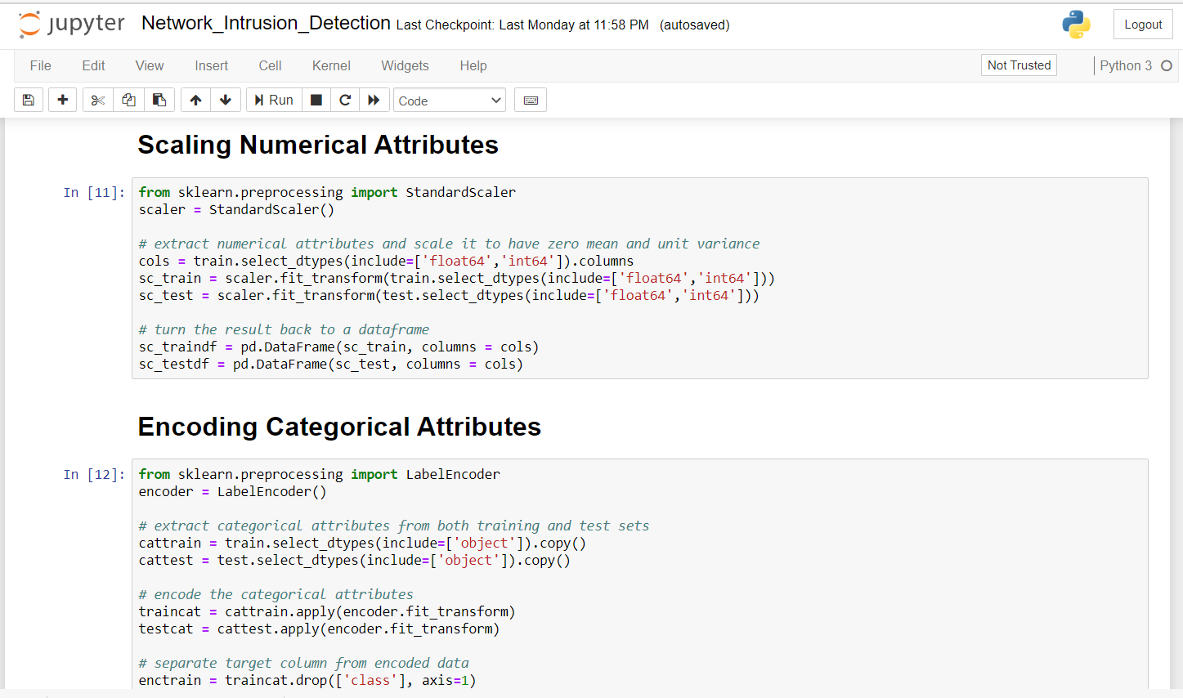
Network Anomaly Detection:

Slide 18
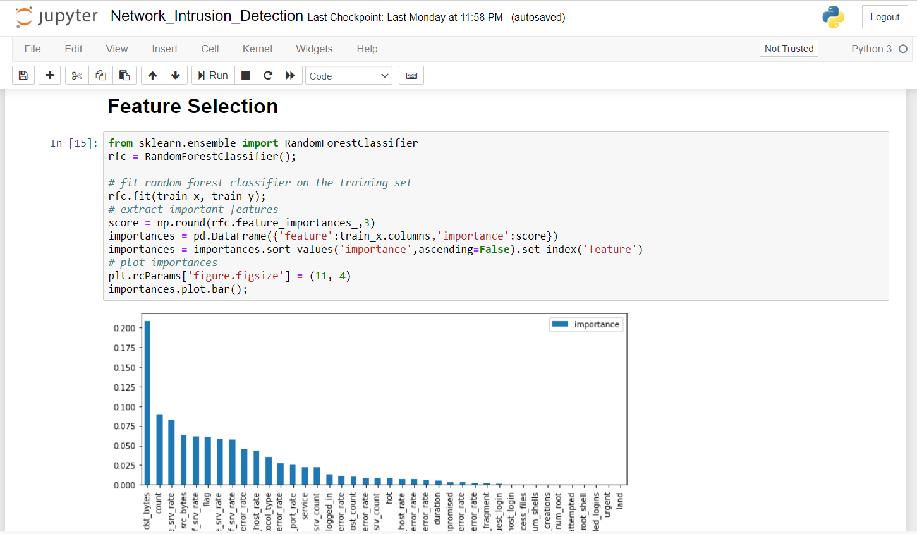
Network Anomaly Detection:

Slide 19
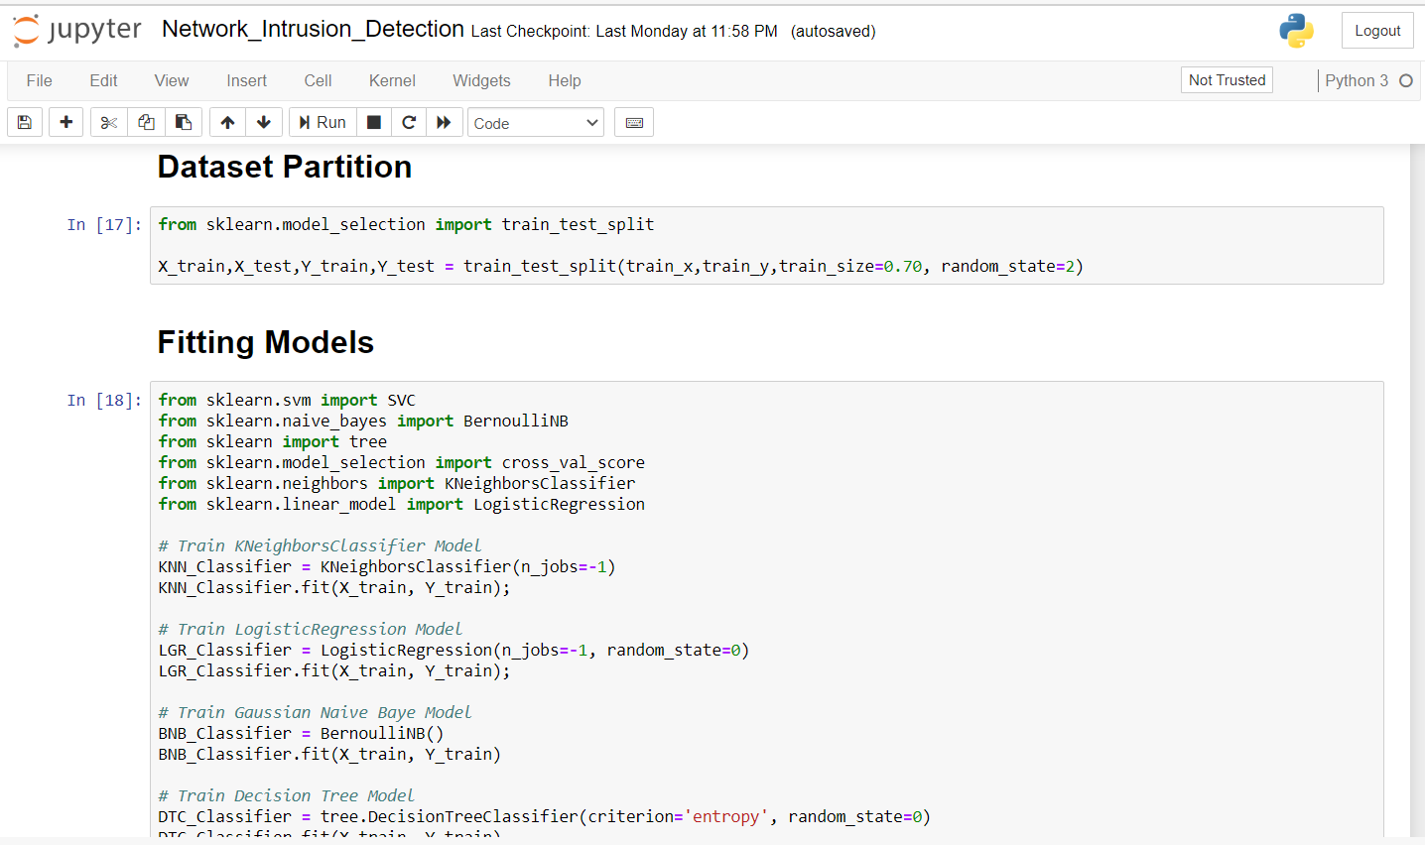
Network Anomaly Detection:

Slide 20
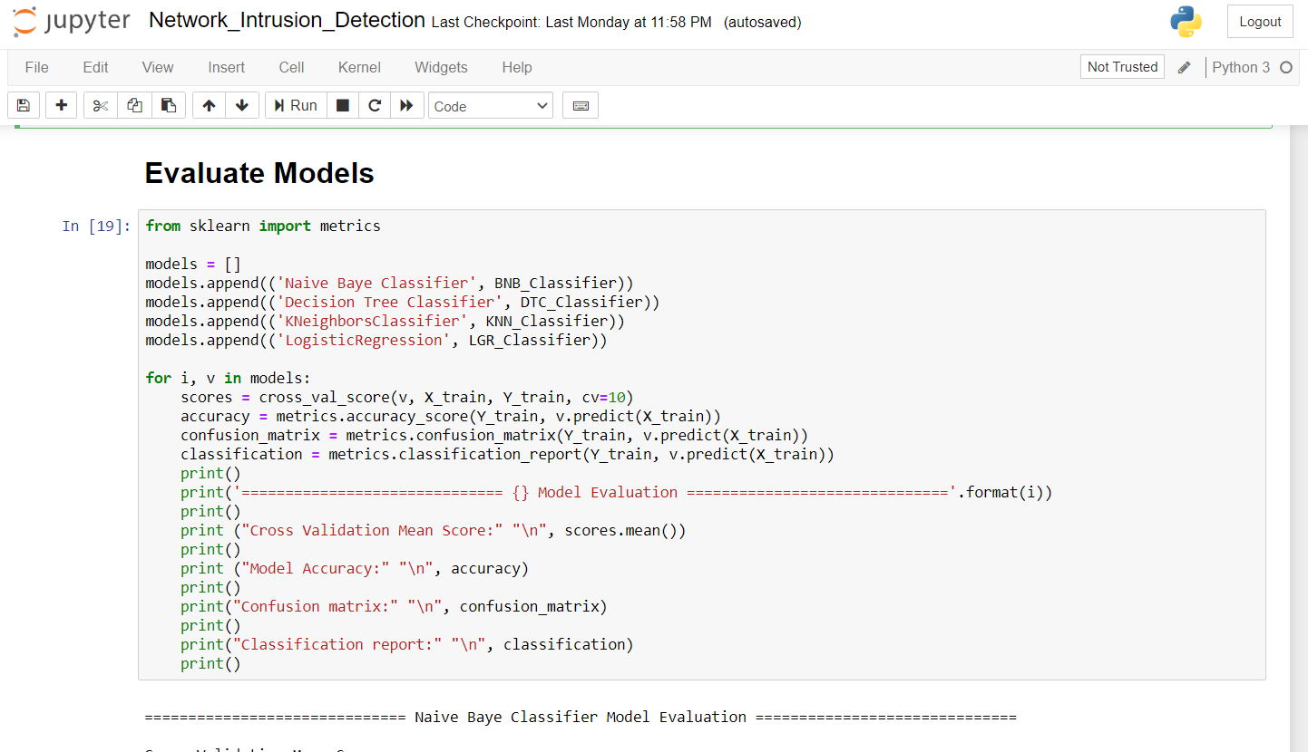
Network Anomaly Detection:

Slide 21
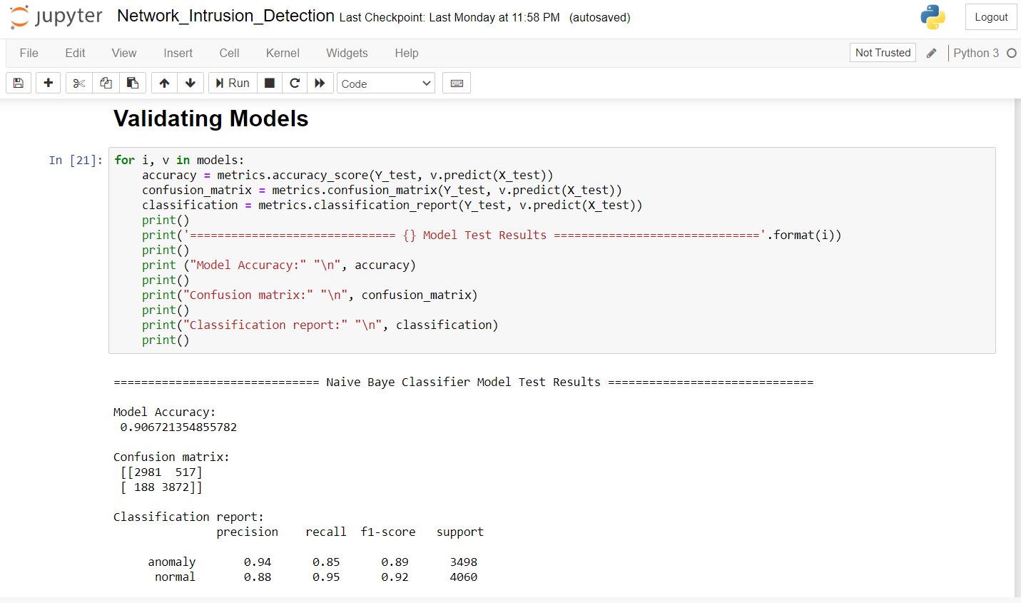
Network Anomaly Detection:

Slide 22
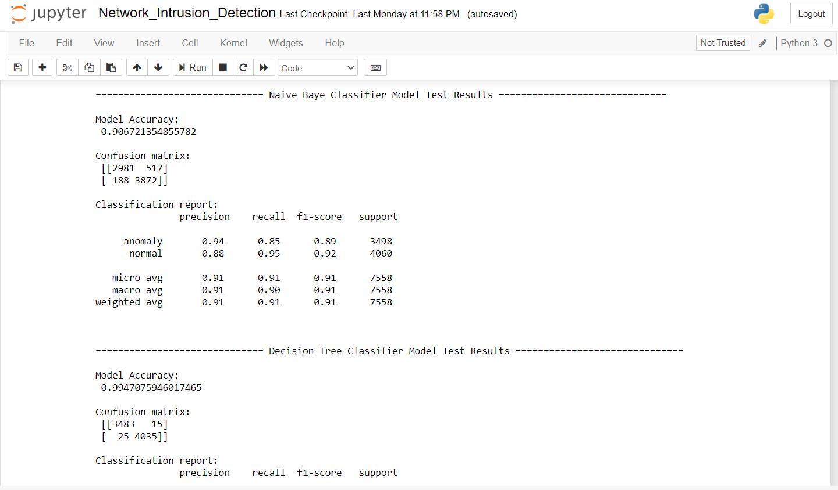
Network Anomaly Detection:

Slide 23
Conclusion:
In this Digital Era everyone is connected through network so it is possible that the huge amount of data in the network channel can create the congestion in the network. So, it is important to analyze the network congestion factors that we can use to reduce the congestion in the network which will also include the security aspects of data packets loss problems.

Slide 24
Thank You!!

